Slide 1
State Machine
#07 More patterns

Slide 2
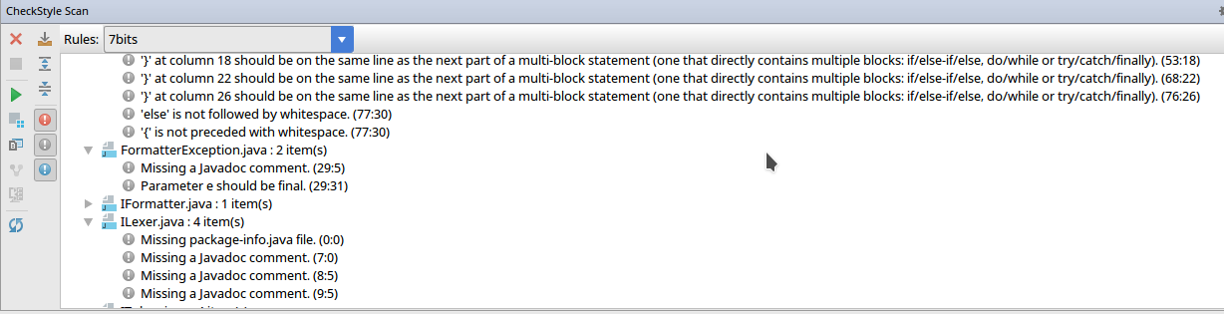
CheckStyle!

Slide 3


Slide 4
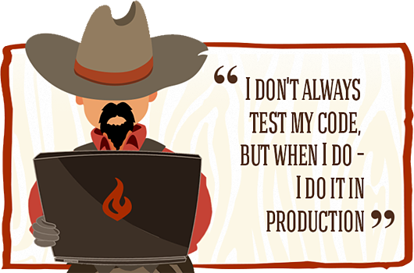

Slide 5
IWriter
public interface IWriter extends IClosable {
void writeChar(String c)
throws WriterException;
}

Slide 6
New Method
void write(char c);
void write(String str);

Slide 7
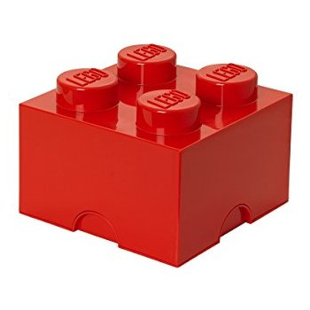
O — Open/Closed
Software entities (classes, modules, functions, etc.)
should be open for extension,
but closed for modification.

Slide 8


Slide 9
New Contract
public interface ICharWriter {
void write(char c);
}
public interface IStringWriter {
void write(String str);
}

Slide 10
Generic Interface
public interface IWriter<T> {
void write(T value);
}

Slide 11
Generic Interface
public class FileWriter
implements IWriter<Character> {
@Override
public void write(Character c) {
//...
}
}

Slide 12
IFormatter
public interface IFormatter {
void format(IReader reader,
IWriter writer);
}

Slide 13
ILexerFormatter
public interface ILexerFormatter {
void format(ILexer lexer, IWriter writer);
}

Slide 14
Hard Dependency
public class Formatter implements IFormatter {
public void format(
final IReader reader,
final IWriter writer) {
ILexer lexer = new Lexer(reader);
//...
}
}

Slide 15
Setter
public class Formatter implements IFormatter {
private final ILexer lexer;
public void format(
final IReader reader,
final IWriter writer) {
this.lexer.setReader(reader);
//...
}
}
Don't do this!

Slide 16
Class Invariant
True condition
Object should always be in a usable state
Lexer has not-null IReader instance (wrapped)
Lexer methods can be invoked
immediately after the object construction

Slide 17
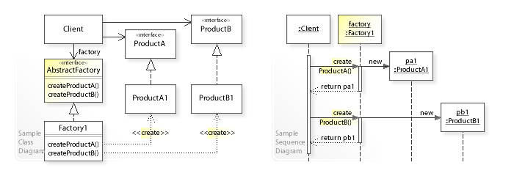
Factory

Slide 18
ILexerFactory
public class Formatter implements IFormatter {
private final ILexerFactory lexerFactory;
public Formatter(
ILexerFactory lexerFactory) {
this.lexerFactory = lexerFactory;
}

Slide 19
ILexerFactory
public class Formatter implements IFormatter {
public void format(
final IReader reader,
final IWriter writer) {
ILexer lexer =
lexerFactory.createLexer(reader);
//...
}
}

Slide 20
Wrapping Exception
} catch (ReaderException e) {
throw new LexerException(e.getMessage());
}
Don't do this!

Slide 21
Wrapping Exception
Exception in thread "main" i.s.c.f.LexerException: Read failed
at i.s.c.f.ExceptionTest.main(
ExceptionTest.java:13)

Slide 22
Wrapping Exception
} catch (ReaderException e) {
throw
new LexerException("Lexer failed", e);
}

Slide 23
Wrapping Exception
Exception in thread "main" i.s.c.f.LexerException: Lexer failed
at i.s.c.f.ExceptionTest.main(ExceptionTest.java:13)
Caused by: i.s.c.f..ReaderException: Read failed
at i.s.c.f.ExceptionTest.main(ExceptionTest.java:11)
Caused by: java.io.IOException: IO failure
... 1 more

Slide 24
Format Result
String InputString = "{
test();
}
";
String ExpectedString = "{
\n test();
\n}
\n";

Slide 25
Formatter Improvements
Support string literals
  "{};" → "{};"
Support comments (single-line, multi-line)
  //{}; → //{};
  /*{};*/ → /*{};*/

Slide 26

State Machine
S — states
X — input alphabet (signals)
Y — output alphabet (signals)
— transition function
— output function

Slide 27
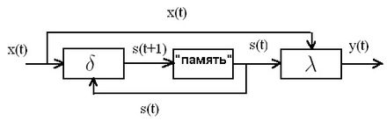
State Machine

Slide 28
Lexer State Machine
Input — characters
Output — token building commands
States — based on prev read chars and prev states
State transitions — by current State and input char
Output commands — by current State and input char
Each nextToken() call starts the State Machine
Final state means the token is ready

Slide 29
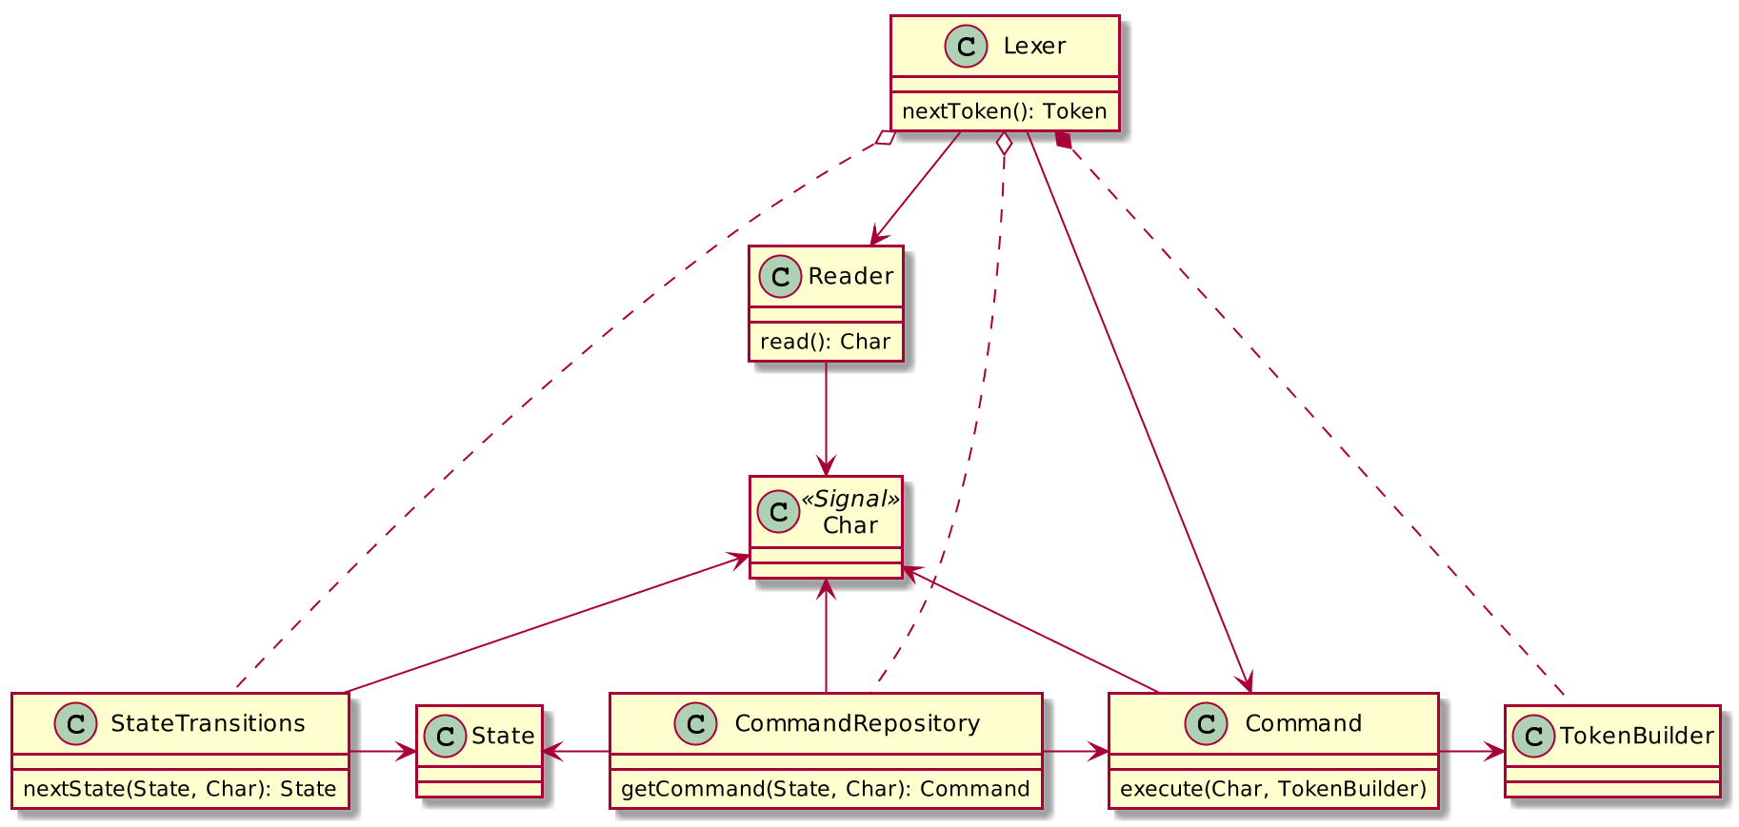
State Machine
Components

Slide 30
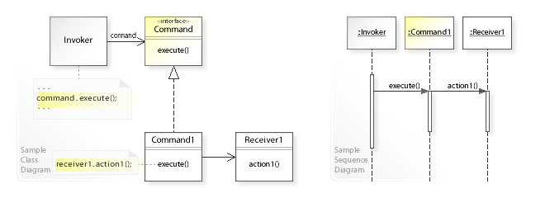
Command

Slide 31
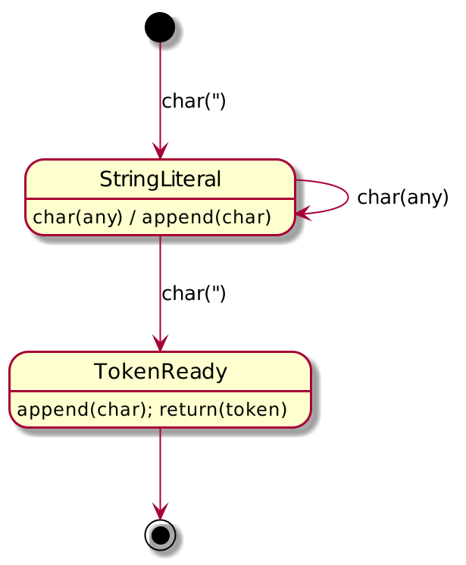
State Diagram

Slide 32
Lexer
fun nextToken(): IToken {
var state: State? = State("initial")
while (reader.hasMoreChars() && state != null) {
val char = reader.readChar()
val command = commands.getCommand(state, char)
command.execute() // TODO: pass TokenBuilder
state = transitions.nextState(state, char)
}
// TODO: handle next char
return newToken()
}

Slide 33
Formatter State Machine
Input — tokens
Output — result writing commands
States — based on prev tokens and prev states
State transitions — by current State and Token
Output commands — by current State and Token
Each format() call starts the State Machine
Final state probably means an error
  The end of tokens means end of the output

Slide 34
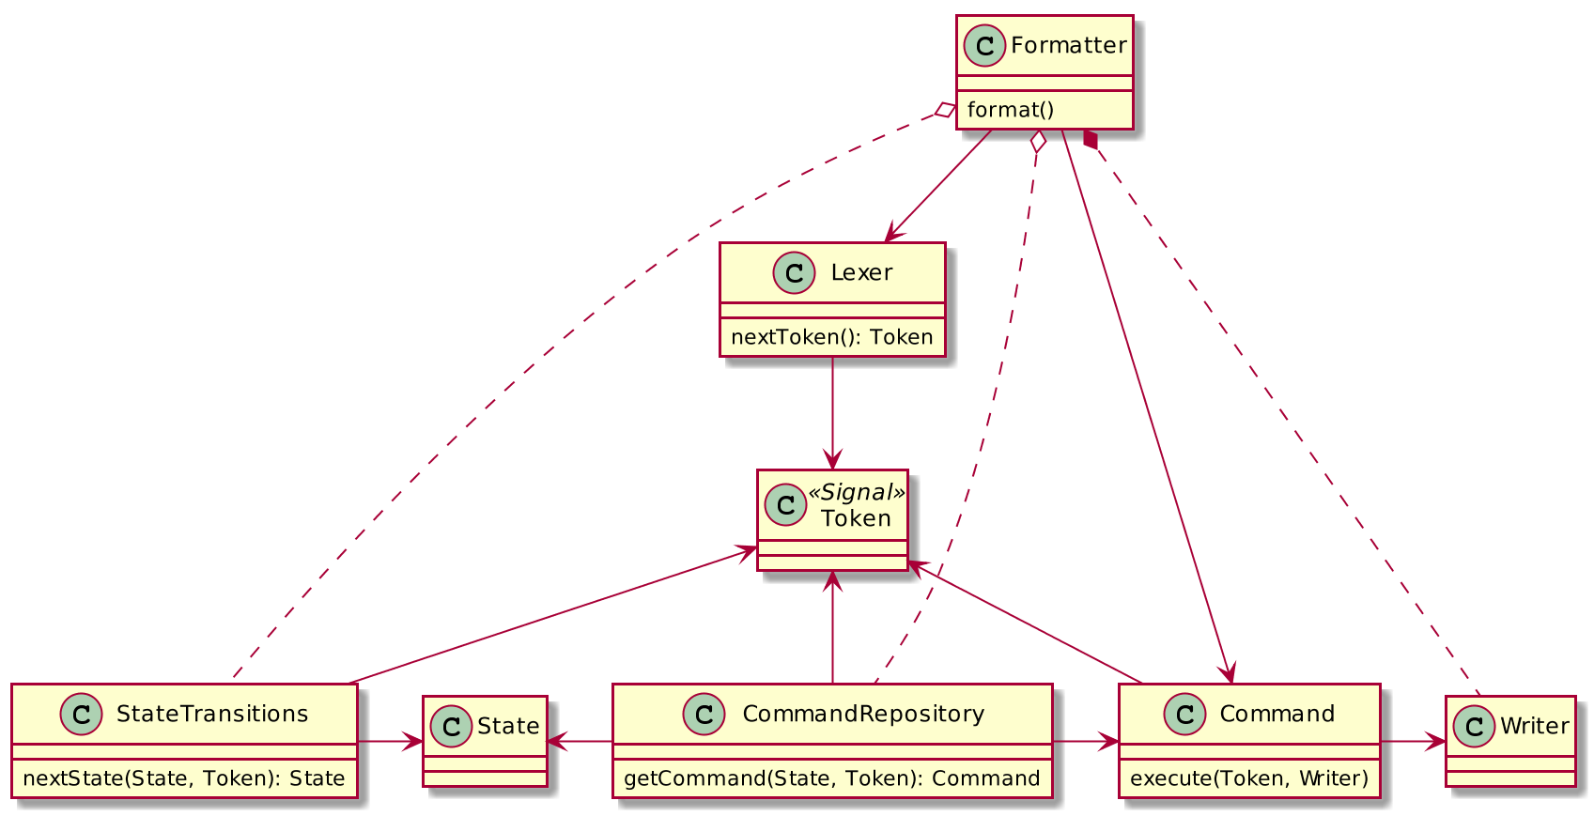
State Machine
Components

Slide 35
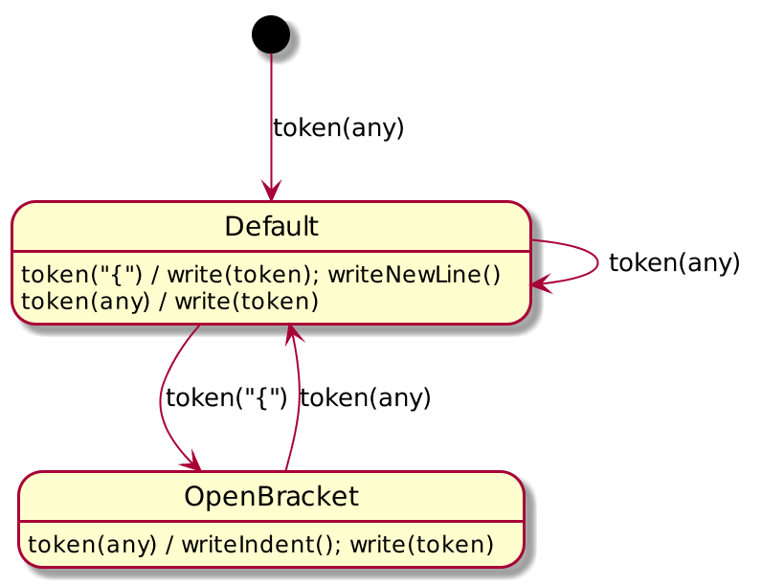
State Diagram

Slide 36
Formatter
fun format(reader: IReader, writer: IWriter<Char>) {
var state: State? = State("initial")
val lexer = lexerFactory.createLexer(reader)
while (lexer.hasMoreTokens() && state != null) {
val token = lexer.readToken()
val command = commands.getCommand(state, token)
command.execute(writer)
state = transitions.nextState(state, token)
}
}

Slide 37
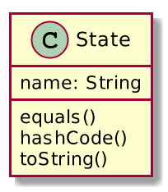
State

Slide 38
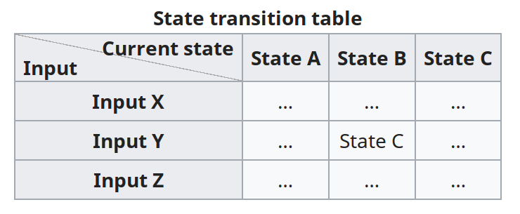
State Transitions

Slide 39
Two Key Map
val transitions:
Map<State, Map<Char, State>>
val transitions:
Map<Pair<State, Char>, State>

Slide 40
Homework
Complete Maven, CheckStyle,
interfaces, Lexer, everything...
Improve Lexer and Formatter
  Support string literals
  Support single-line and multi-line comments
  https://en.wikipedia.org/wiki/Finite-state_machine
  https://en.wikipedia.org/wiki/Command_pattern
  https://en.wikipedia.org/wiki/Abstract_factory_pattern

Slide 41
Homework
To: back-teachers@7bits.it
Subj: Java Homework #07
Deadline: Sunday 23:59 (midnight)
https://7bits-courses.slack.com/messages/C7R2R4AMB/

